Slide 1
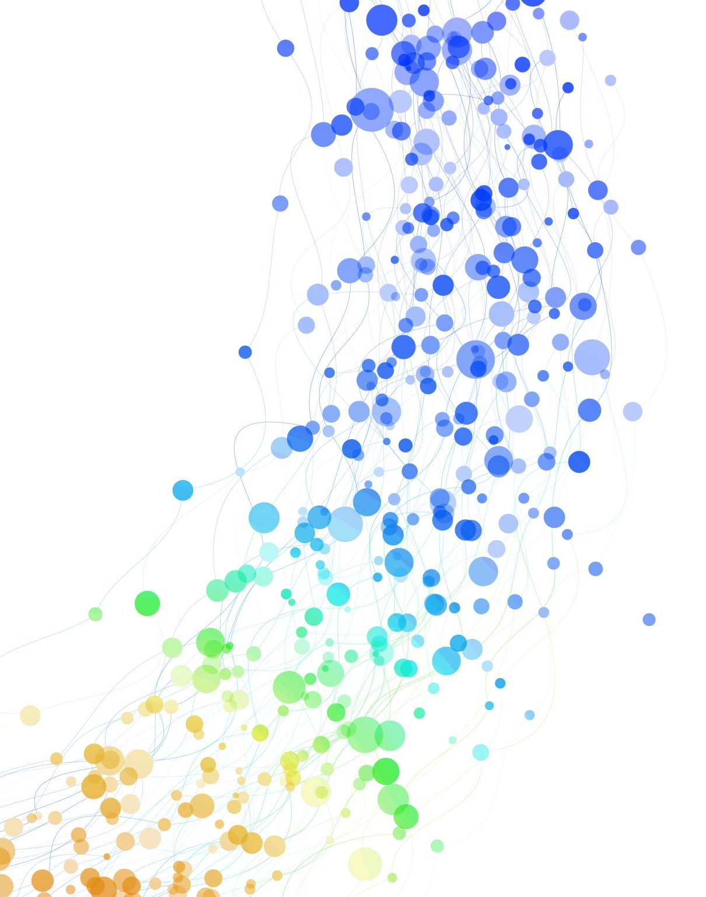
DengAI: Predicting Disease Spread
Members:
Kevin
Gabriela
Natanael

Slide 2
Introduction
Background:
Dengue fever is a mosquito-borne disease prevalent in tropical and subtropical regions.
Transmission dynamics are influenced by climate variables like temperature and precipitation.
Significance:
Accurate prediction of dengue outbreaks aids public health initiatives and resource allocation.
Objective:
Develop machine learning models to predict dengue outbreaks using climate and disease data.

Slide 3
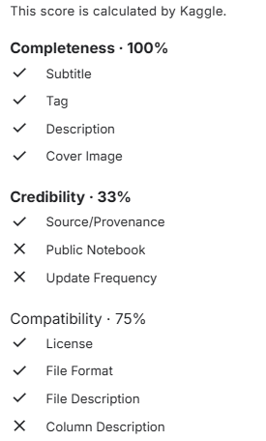
First Dataset:
Data from Zona da Mata, Minas Gerais, Brazil.
Sources: INMET and DATASUS/SINAN.
Issues: Low data quality and reliability, potential inadequate preprocessing

Slide 4
Second Dataset (DengAI):
Second Dataset (DengAI):
Weekly dengue case counts and environmental variables for San Juan (Puerto Rico) and Iquitos (Peru).
There was a benchmark that had one strong issue which was it couldn’t predict peaks/outbreaks correctly

Slide 5
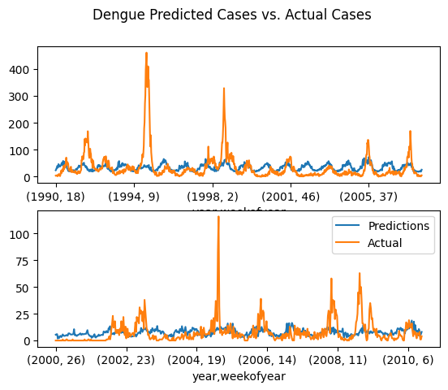
Benchmark
Performance
San Juan
MAE: 22.08
R2: 0.14
MSE: 756.98
Iquitos
MAE: 6.47
R2: 0.0036
MSE: 119.32

Slide 6
First Approach
The first approach was simple, swapping the model used for a different one
The models used were KNN Regression, Decision Tree Regression, SVM Regression, and Random Forest Regression
How the data was handled was equivalent to how the benchmark did apart from normalizing the features
Hyperparameters were tuned using GridSearchCV
In a way it was a way to compare the model they used to ones we knew about, as well as perhaps gain insight into we would need to improve the performance

Slide 7
First Approach Results
Generally, all the models apart from one simply ended converging towards about the same result as the benchmark
SVM was the only the model to perform better having a MAE of about 17.07
Even then it still faced the same issue where the peaks/outbreaks weren’t correctly predicted

Slide 8
Insights and Lead up to Second Approach
It was obvious that for this particularly problem a simple model swap wouldn’t necessarily improve performance
This was further shown with the first approach as well as when simply adding the vegetation indexes 2 models got better performance than the benchmark
Although the same issue resides where outbreaks aren’t correctly predicted

Slide 9
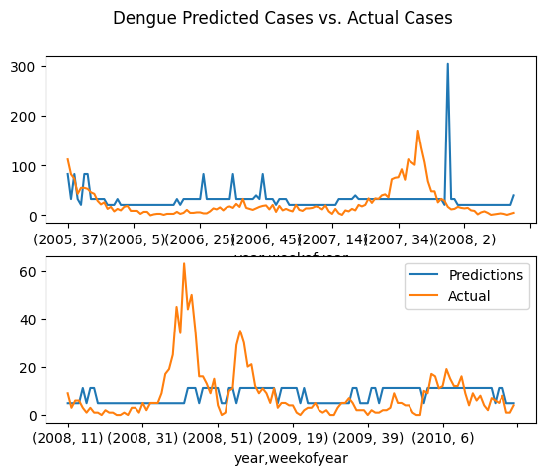
Decision Tree Regression
San Juan
MAE: 23.03
R2: -0.65
MSE: 1446.34
Iquitos
MAE: 6.78
R2: 0.00062
MSE: 119.67

Slide 10
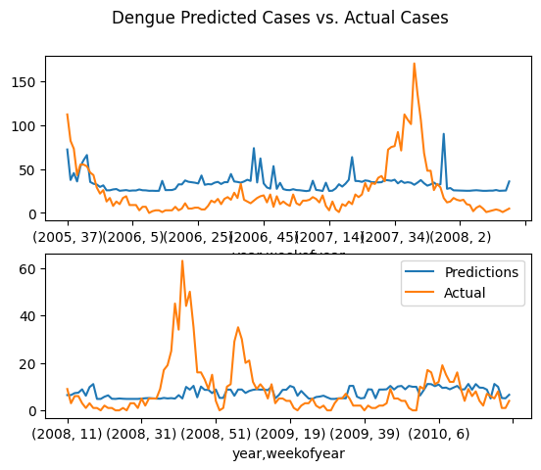
Random Forest Regression
San Juan
MAE: 22.87
R2: -0.01
MSE: 884.73
Iquitos
MAE: 6.61
R2: 0.0034
MSE: 119.34

Slide 11
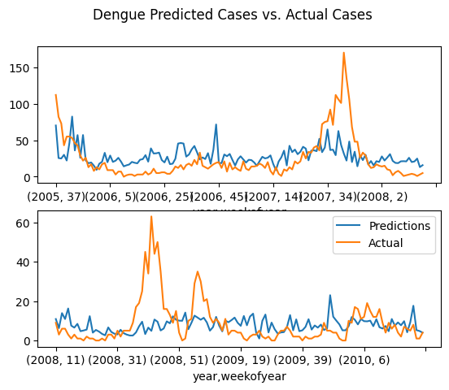
KNN Regression
San Juan
MAE: 19.24
R2: 0.17
MSE: 728.90
Iquitos
MAE: 7.2962
R2: -0.061
MSE: 127.06

Slide 12
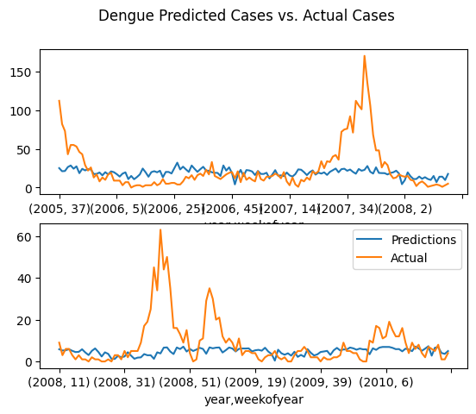
SVM Regression
San Juan
MAE: 17.19
R2: 0.06
MSE: 823.64
Iquitos
MAE: 6.49
R2: -0.104
MSE: 132.21

Slide 13
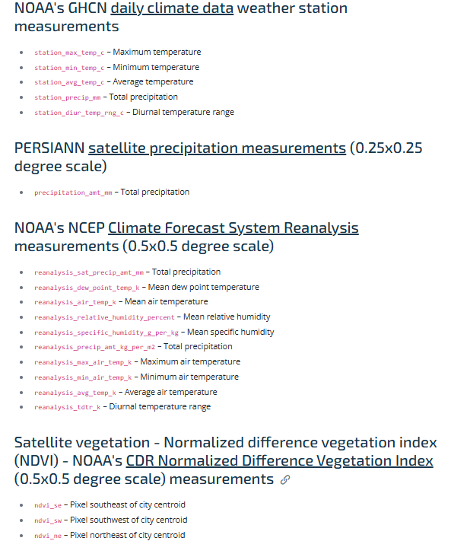
Second Approach:
Feature Engineering

Slide 14
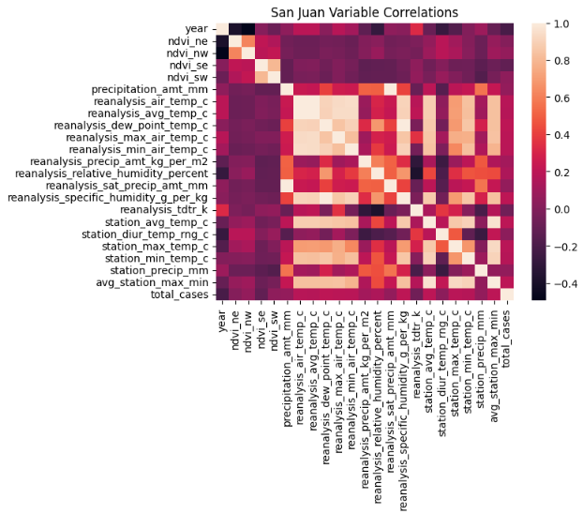

Slide 15
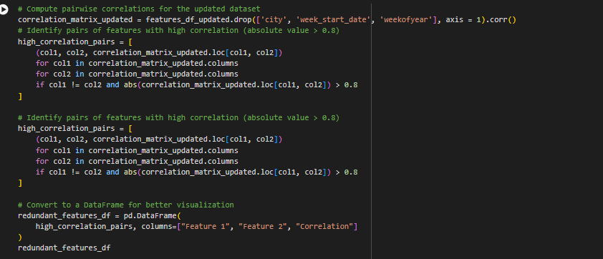

Slide 16
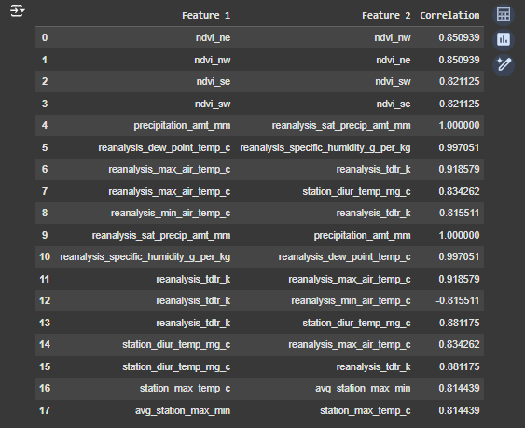
Selected features and their relevance to dengue outbreaks
Remove Dummies Approach (NEXT)

Slide 17
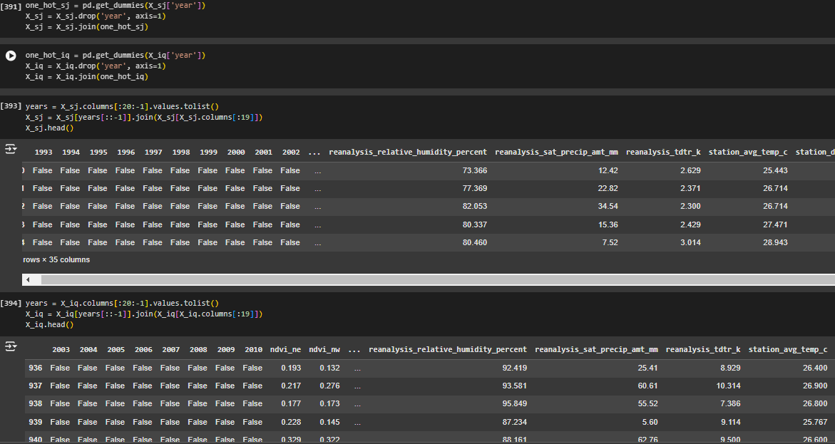

Slide 18
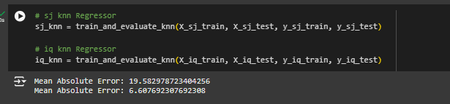
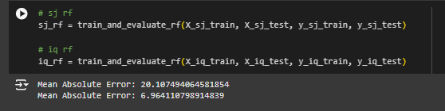
Second Approach Results
K-Neighbors
Regressor
Random forest

Slide 19
Third Approach
Taking a look back at the Decision Tree Regression Graph we noticed that it does almost predict a peak, but kind of delayed
The non-improvement through feature selection and engineering showed perhaps we need a temporal factor and a model that could handle that

Slide 20
Third Approach
https://acrobat.adobe.com/id/urn:aaid:sc:VA6C2:91e682a0-ec6c-473d-bc74-7f7efa68d965

